Slide 2

Database System Lab Project
Thunder - Energy Intelligence Platform
Telecommunication’s Energy Data Analysis Dashboard
Content of Project Presentation:
What is this project?
Why it matters (Real Life Application)
Features Overview.
DB Concepts Used
Technologies Used.
In-depth feature Review.
Syed Hassnain Abbas
23P-3029
BSE-4A

Slide 3
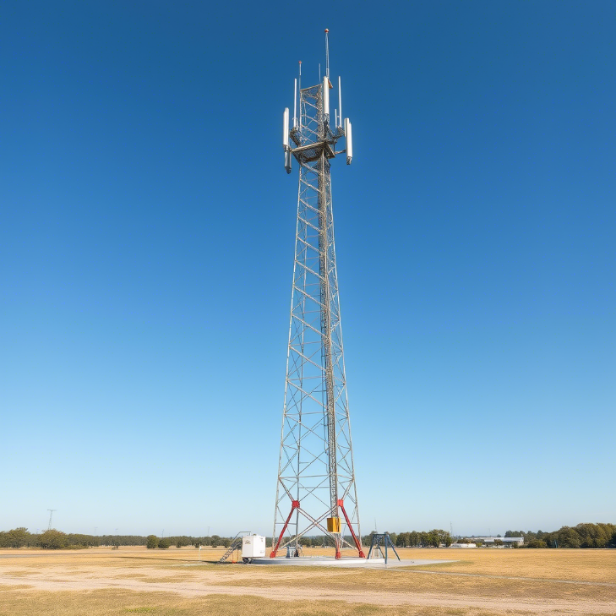
What is this project?
This project is a part of my internship task where I was assigned to create a
Telecommunication’s energy data analysis dashboard for Telenor towers.
The data is fetched from the IOT sensor on those sites and then stored in the DB, then the data is fetched via python
and data manipulation is done on the data to make it appropriate for analysis and visualizations.
I manage Telenor’s towers by performing analysis of:
Active power sources used to charge batteries
Identify load share at a specific time
Training time series model to predict load shedding patterns
Daily load shedding analysis
Smart Battery Tracker
Single Tower from a site

Slide 4
Overview of Features
Login
Active Power Source
Daily Load Shedding
Smart Battery Tracker
Load Shedding Prediction
Load Share %

Slide 5
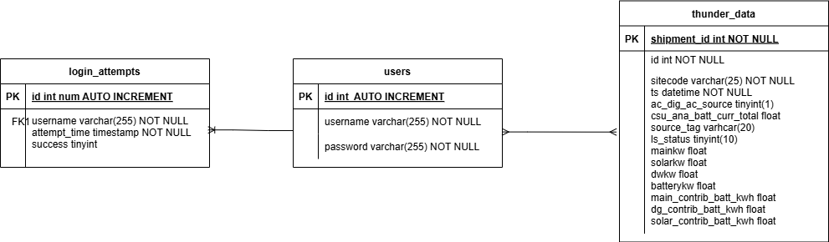
DB concepts used
ERD
DB Creation
DB Configuration
Data Insertion into the DB
Setting Key’s (primary, foreign)
Trigger
Queries
Join’s
Cursor
ERD

Slide 6
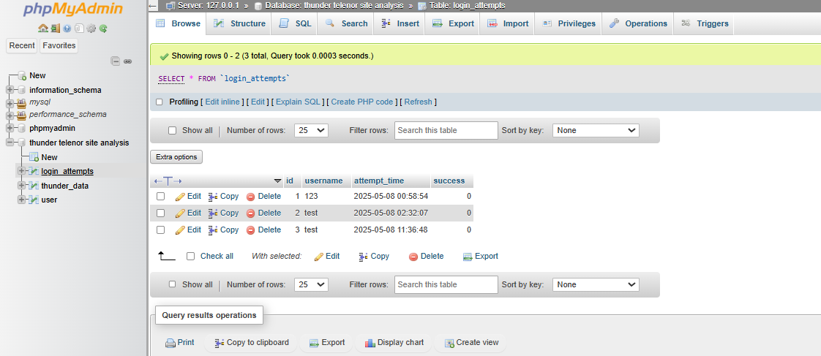

Slide 7
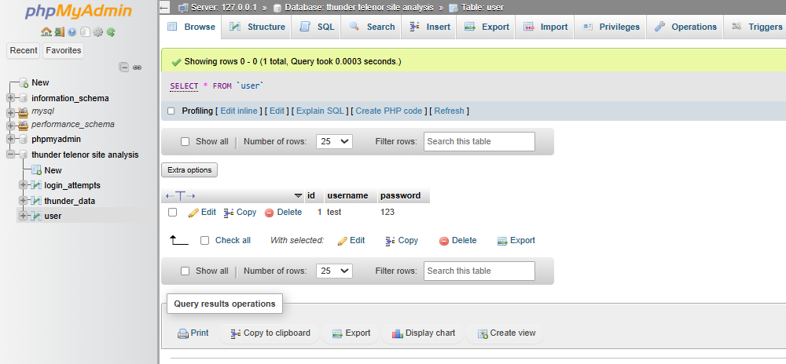

Slide 8
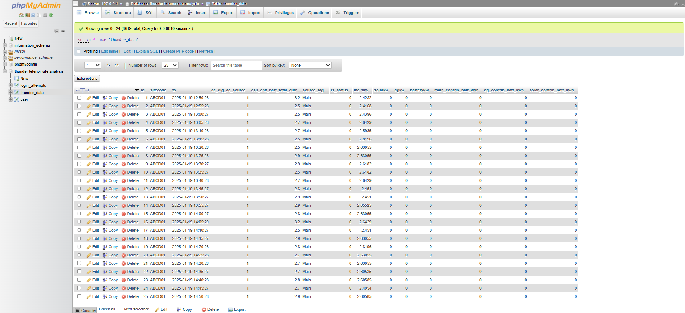

Slide 9
Real World Applications For Telenor
Active power sources:
Identify the power sources which are charging/powering the tower to transmit signals.
for example -> solar, main, batteries.
Identify load share:
Determine the load share % to identify how much of percent each source is providing at a particular time to ensure efficiency
And make sure that sources are not wasted
For example -> solar 50%, batteries 50% -> efficient use
40% solar, 20% main, 45% batteries -> energy wastage.
Load shedding prediction:
Used to identify the load shedding patterns predict when next load-shedding could occur so they encounter it by charging batteries, It becomes cost efficient and also anomalies can be identified.
Daily load shedding analysis:
Data of load shedding occurs in Boolean from the IOT sensor, so its very difficult to identify the load shedding live. So its
Plotted visually to make it easy to encounter several site load-shedding issues.
Smart Battery Tracker:
It is impossible to identify from the raw dataset if the battery is being charged or not, and if its efficiently charged, so this
feature allows Telenor to track their battery usage.

Slide 10
Technologies Used
Backend Technologies
Python
Why: rich ecosystem of libraries for data manipulation, machine learning, and database access.
Libraries Used:
pymysql: Connects to the database and retrieves/query data.
Pandas: Manipulates and preprocesses data (resampling timestamps, handling missing values).
plotly.graph_objects: Creates interactive charts (e.g., bar charts) that are converted to JSON for frontend rendering.
statsmodels.tsa.statespace.sarimax: Trains a SARIMA model for time-series forecasting of load shedding data.
numpy: Performs numerical operations on data.
flask_caching: Implements caching mechanisms to optimize API performance (e.g., caching predictions for 1 hour).
CORS: Cross-Origin Resource Sharing (CORS), allowing the frontend (hosted on a different domain) to securely access the backend APIs.
Postman: To test the API requests.

Slide 11
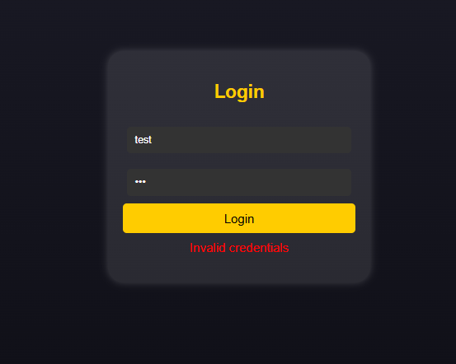
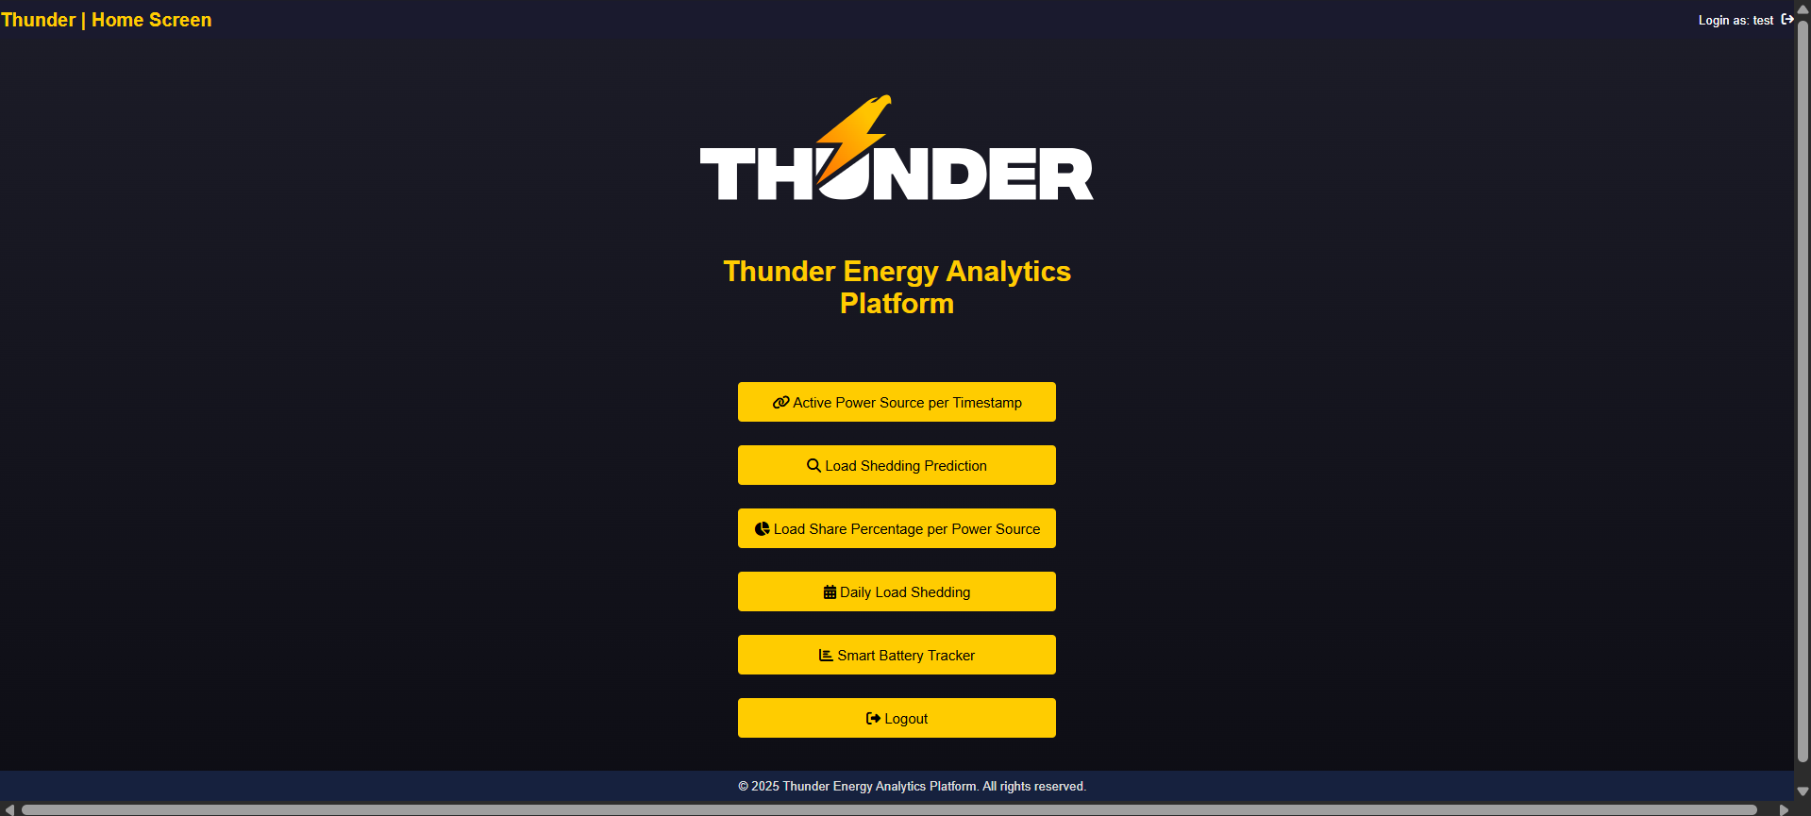
Login
Users information is fetched from the database
to login, if incorrect information, exception checks
are used to encounter it.
On successful login, we head to main page

Slide 12
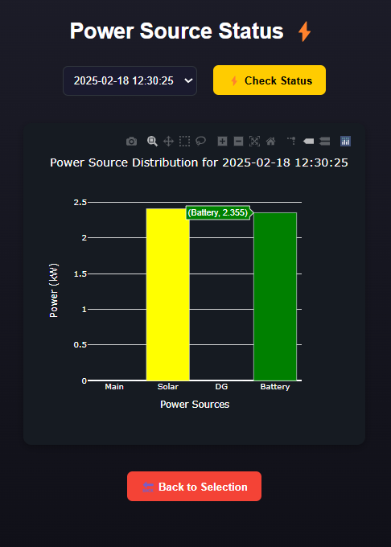
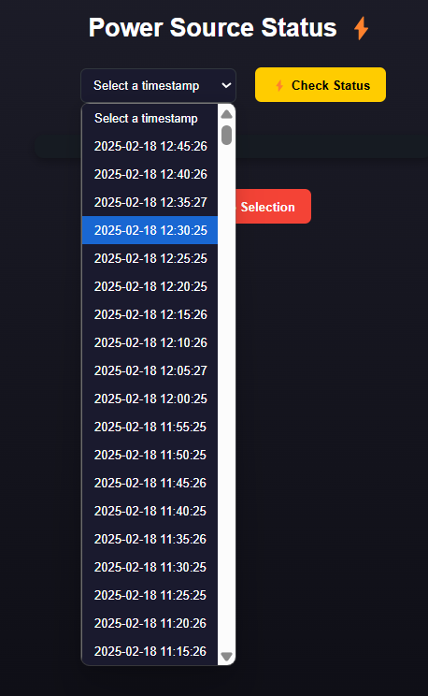
Active Power Source
The timestamps are fetched from the database
and displayed for the user to choose from.
On choosing a timestamp, the current active power sources
are shown visually to see how much “kW” is being used for
each to also identify energy wastage.

Slide 13
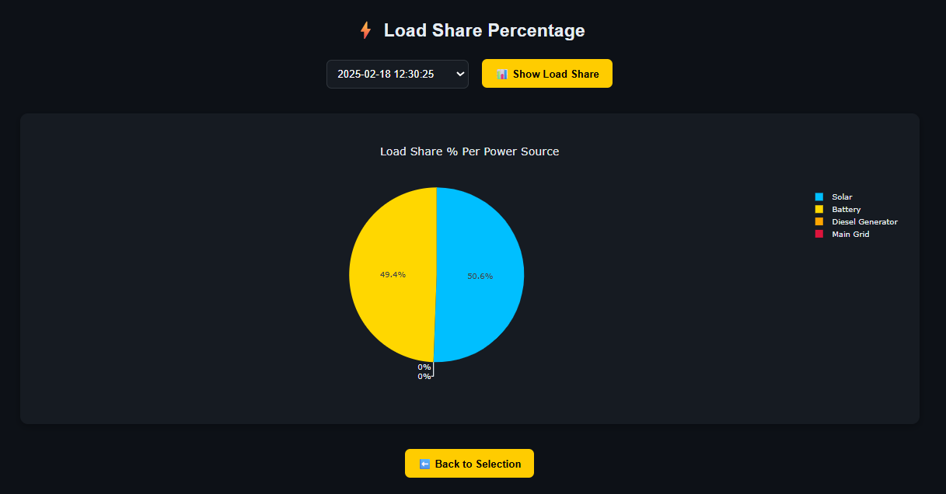
Load Share Percentage

Slide 14
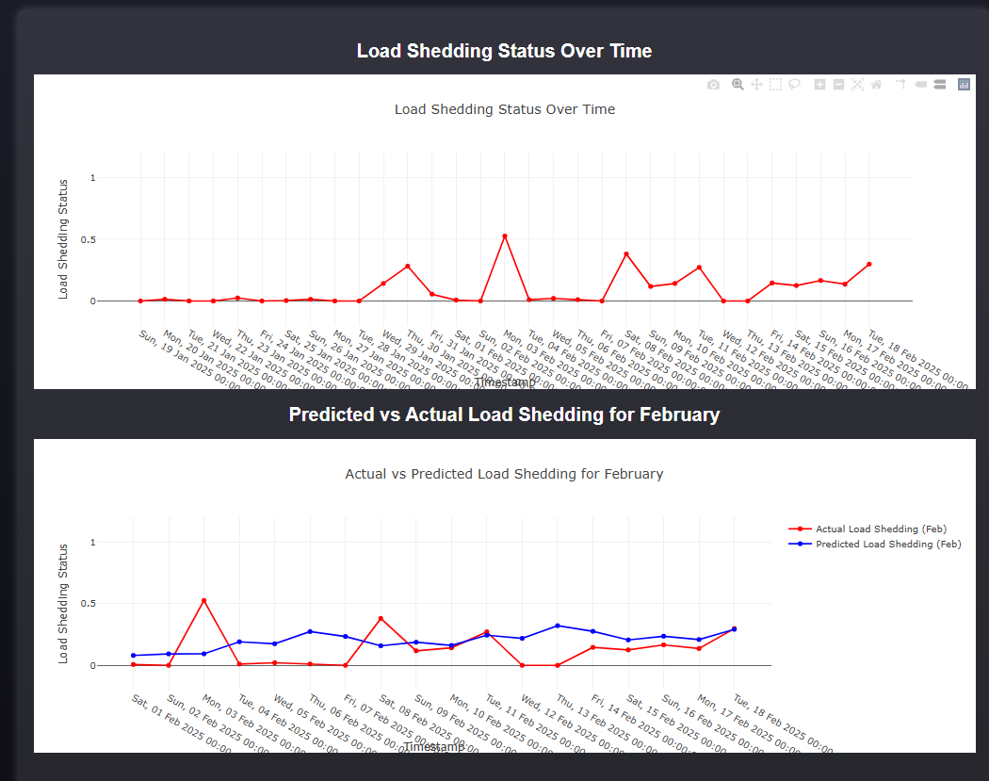
Load Shedding Prediction
Above graph showcases the overall ls status.
Below Graph:
How the prediction is made:
Data is fetched then manipulated:
Missing values are averaged out.
Filtering out actual data
Calculating the percent of ls status
Time-Series Model “SARIMA” Seasonal AutoRegressive
Integrated Moving Average is trained on the manipulated
Data
Added seasonality to the model of weekly, along with other
parameters like differencing and moving averages.
Plotted the data in comparison with actual data.

Slide 15
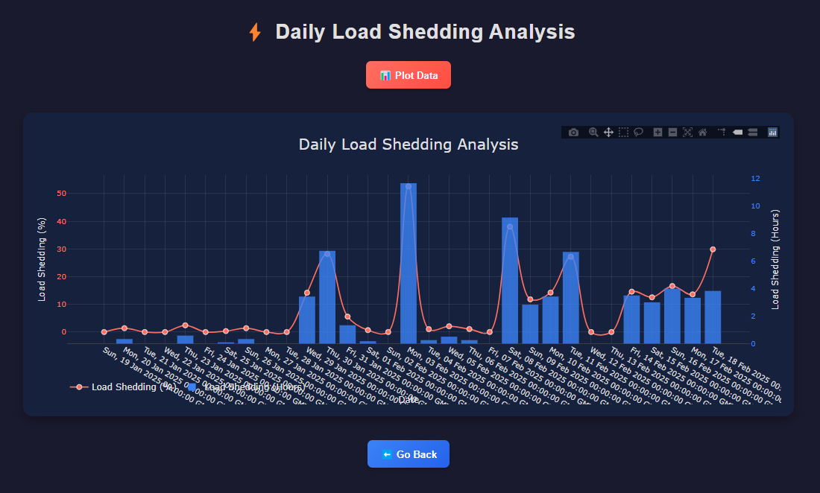
Daily Load Shedding
How Daily Load Shedding is calculated:
Fetch the load shedding data
Filter out and total the data by per day.
Replacing the null values as 0
Calculate load shedding per day by counting where
ls status was active (ls_status==1)
Calculate the loadshedding % -> (ls_count/total)*100
Calculating the hourly ls_status -> ls_count*interval/60
Return in json format so that its fetched via the api and
Plotted on front end.

Slide 16
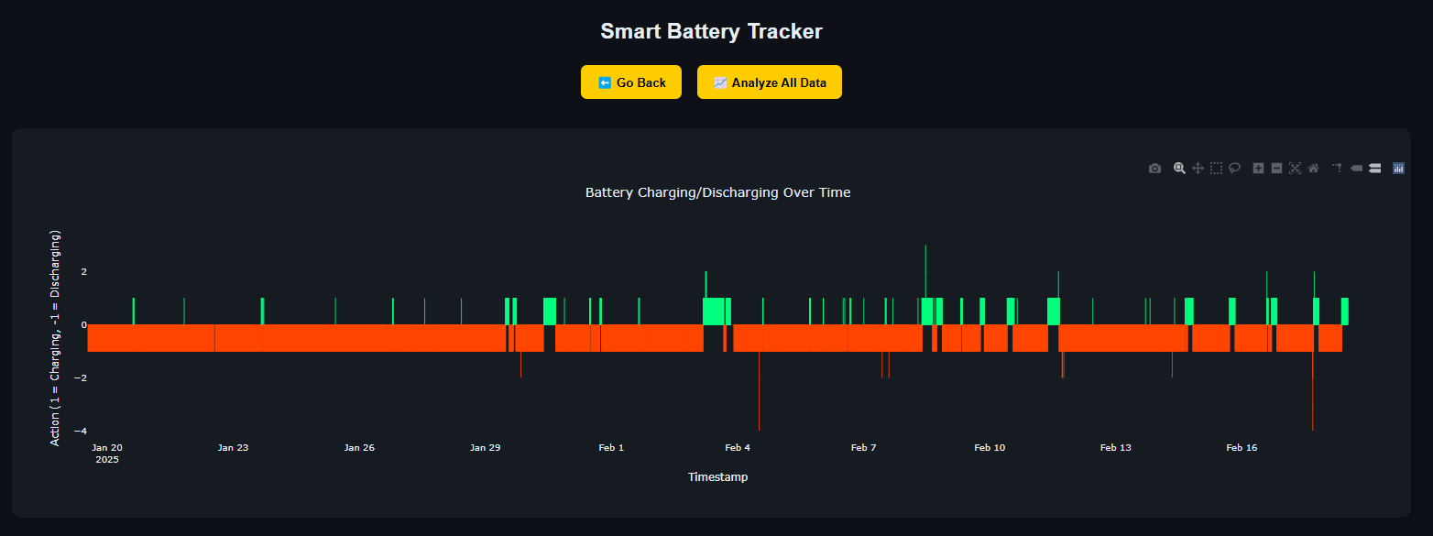
Smart Battery Tracker
How Battery is Tracked after analyzing the raw data:
Determine charging/discharging action
If “csu_ana_batt_total_curr” is >0 it means
battery discharging else -> charging
Determine power source:
If “ac_dig_ac_source” ==1 then it means source
used for energy is “external source”
else-> battery.
Determine energy flow direction:
If “main_contrib_batt_kwh” <0 then energy taken
by main energy
Else -> energy added
If “dg_contrib_batt_kwh” <0 then energy taken by
diseal generator
else -> energy added
If “solar_contrib_batt_kwh” <0 then energy taken
by solar
else -> energy added

